Slide 1
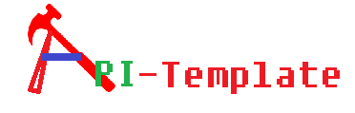


Cooked & Served by Code Chefs
#ls
Akrur Basabendra Jaya Akash

Slide 2



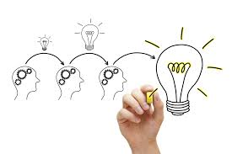




API requirement understanding
RAML definition
Mule Project Creation
Mule Flow creation
Request Processing
Marshalling
Integration with JMS
SSL queue connectivity
Un-marshalling
Prepare security traits
Custom Business Logic
Configuration driven response/error handling

Slide 3
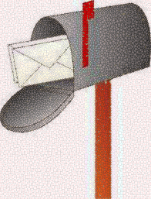



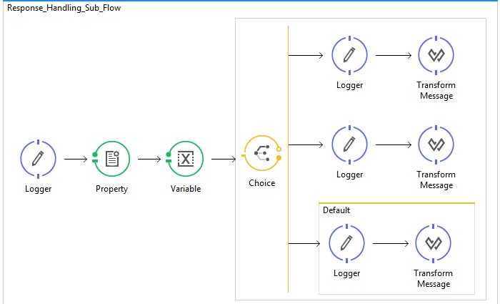
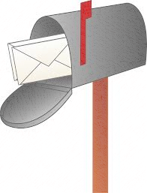

Req MQ
Backend System / Staas Mock
Artifact
Res MQ

Slide 4
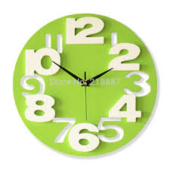



Time and Effort to create API
Development time and efforts reduction
Cost reduction
Standardization
Easy to Adapt
Less defects

Slide 5


